Slide 1
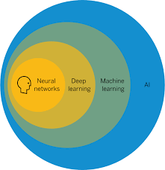
PROJECT TITLE
LOAN PREDICTION USING MACHINE LEARNING
PROJECT TEAM MEMBERS
CHADALAWADA V V KASYAP 20BCE7457
ROHITH VENKAT GUPTHA 20BCI7159

Slide 2
INTRODUCTION:
Machine learning is a subfield of artificial intelligence, which is broadly defined as the capability of a machine to imitate intelligent human behavior. Artificial intelligence systems are used to perform complex tasks in a way that is similar to how humans solve problems.
What are the different types of machine learning?
Classical machine learning is often categorized by how an algorithm learns to become more accurate in its predictions. There are four basic approaches: supervised learning, unsupervised learning, semi-supervised learning and reinforcement learning. The type of algorithm data scientists choose to use depends on what type of data they want to predict.

Slide 3

Literature Survey
This is a classification problem in which we need to classify whether the loan will be approved or not. classification refers to a predictive modeling problem where a class label is predicted for a given example of input data.

Slide 4
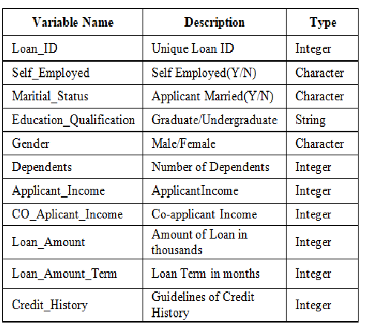
Dataset Description

Slide 5
Methodology:
List of Common Machine Learning Algorithms
Here is the list of commonly used machine learning algorithms. These algorithms can be applied to almost any data problem:
Linear Regression
Logistic Regression
Decision Tree
SVM
Naive Bayes
kNN
K-Means
Random Forest
Dimensionality Reduction Algorithms
10. Gradient Boosting algorithms
GBM
XGBoost
LightGBM
CatBoost

Slide 6
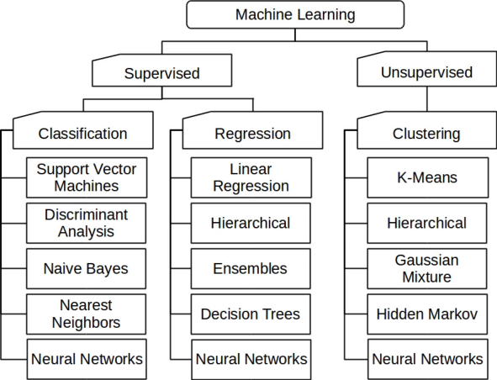

Slide 7
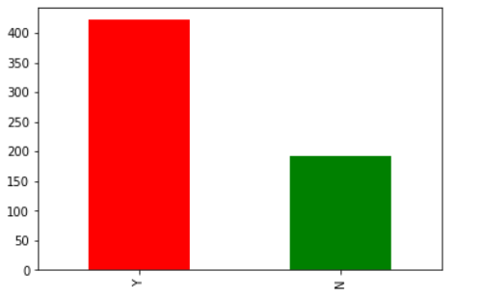
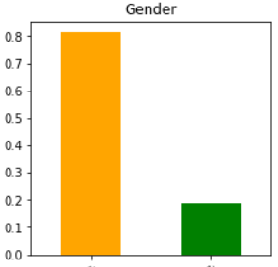
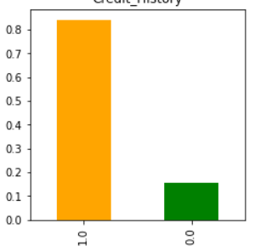
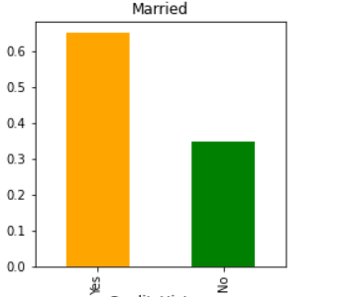
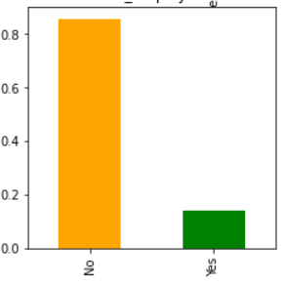
Results Data Visualization for each variable
Gender
Loan Status
Married
Credit history
Self employed

Slide 8
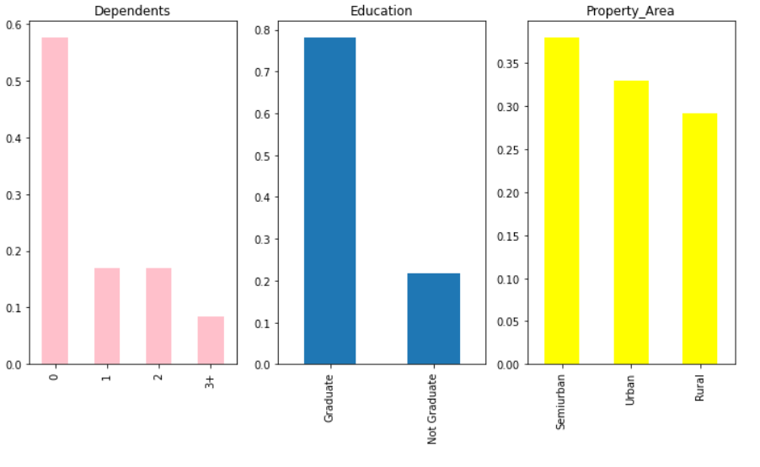

Slide 9
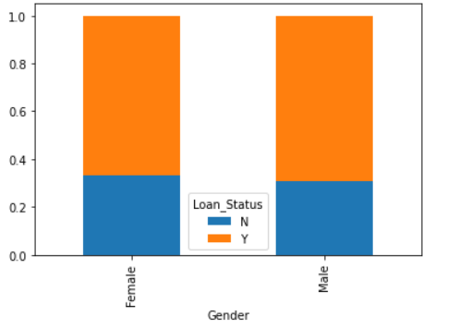
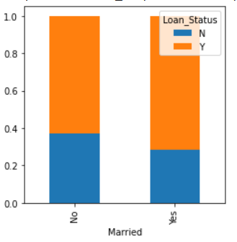
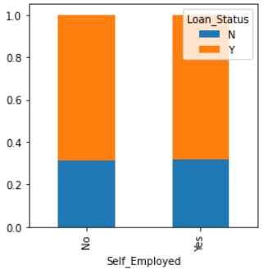
Loan status for Male and Female depicting graph
Loan status for married and unmarried
Loan status for self employed and others

Slide 10
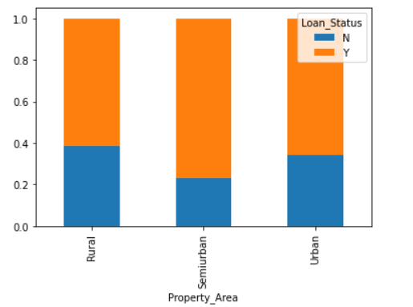
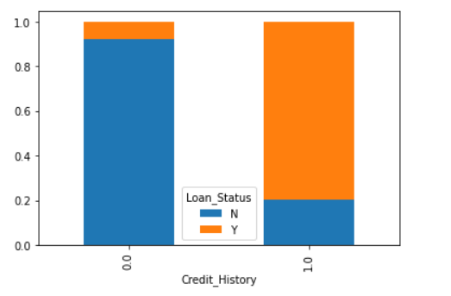
Loan status for property area and credit history

Slide 11
Conclusion: Algorithms used for predicting loan approval in our Project
SVM
Logistic regression
Random Forest
Decision tree
Naïve bayes
XGBOOST

Slide 12

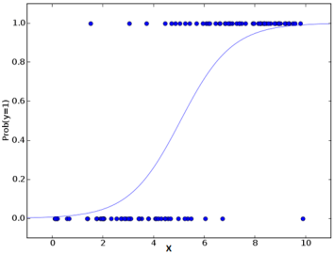
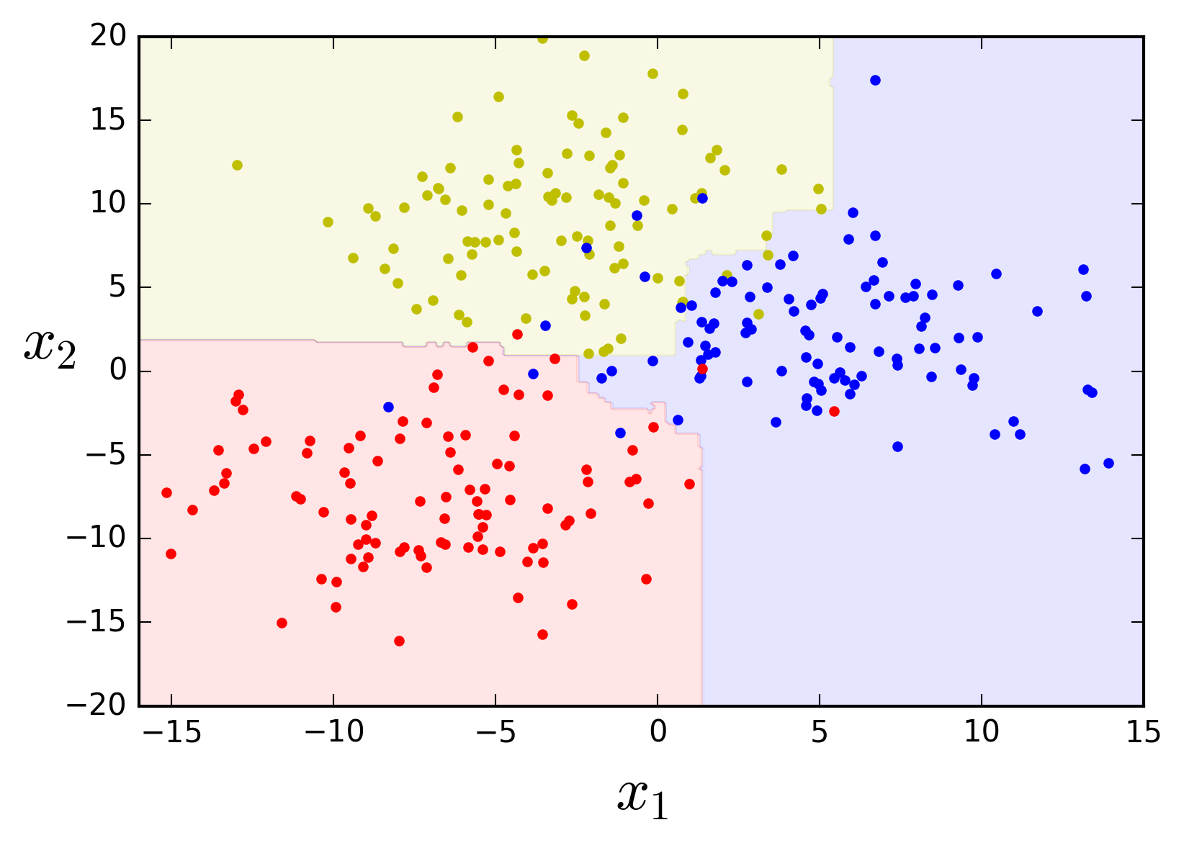
Algorithm Used | Accuracy in Research Paper | Accuracy got by implementing
SVM | 73.2% | 83%
Logistic regression | 77% | 83%
Random Forest | 81% | 83%

Slide 13
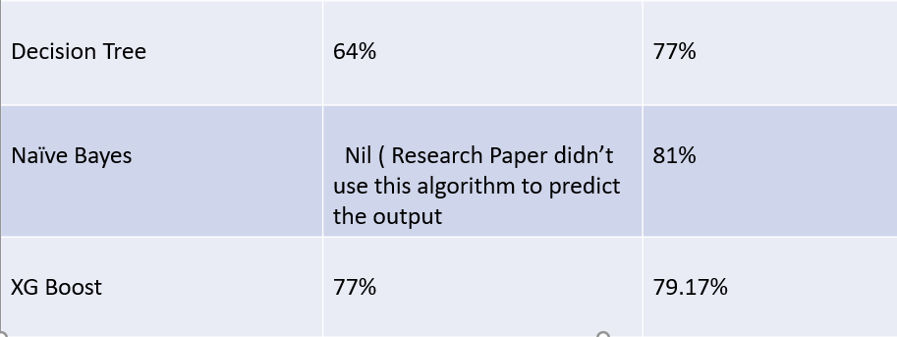
Therefore the highest percentage of accuracy is given by Logistic Regression , SVM and Random Forest which is 83%

Slide 14
References
“Comparative Analysis of Customer Loan Approval Prediction using Machine Learning Algorithms’’ by Praveen Tumuluru 1 Lakshmi Ramani Burra 2 M.Loukya1 Department of CSE
“Prediction of Modernized Loan Approval System Based on Machine Learning Approach” by Vishal Singh Ayushman Yadav and Rajat Aswathi (Btech).
Sheikh Mohammad Ahmad, Amit Kumar Goel, and Tapas Kumar. "An Approach for Prediction of Loan Approval using Machine Learning Algorithm." 2020 International Conference on Electronics and Sustainable Communication Systems (ICESC). IEEE, 2020.

